Slide 1


Hiring Process Analytics
Name – HEMANT MURKUTE
EMAIL – murkutehemant21@gmail.com

Slide 2
Analysis done on the following points:-
Hiring: Process of intaking of people into an organization for different kinds of
positions.
Your task: How many males and females are Hired ?
Average Salary: Adding all the salaries for a select group of employees and then dividing the sum by the number of employees in the group.
Your task: What is the average salary offered in this company ?
Class Intervals: The class interval is the difference between the upper class limit and the lower class limit.
Your task: Draw the class intervals for salary in the company ?
Charts and Plots: This is one of the most important part of analysis to visualize the data.
Your task: Draw Pie Chart / Bar Graph ( or any other graph ) to show proportion of people working different department ?
Charts: Use different charts and graphs to perform the task representing the data.
Your task: Represent different post tiers using chart/graph

Slide 3
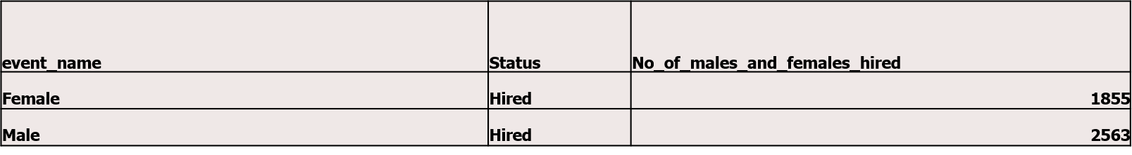

Hiring
CCCCCC
Hiring:
Process of intaking of people into an organization for different kinds of positions.
Your task: How many males and females are Hired ?
No_of_Males_and_Females_Hired
HIRED
MALE
2563
FEMALE
1855
HIRED
0
500
1000
1500
2000
2500
3000

Slide 4
.
Average Salary
Average Salary:
Adding all the salaries for a select group of employees and then dividing
the sum by the number of employees in the group.
Your task: What is the average salary offered in this company ?
To find the average salary offered in this company:-
First, we need to remove the outliers i.e. to remove the salaries below 1000 and above 100000
Then using the formula
=AVERAGE(entire_column_of_salary_after_removing_outliers)
Formula Used:-
=AVERAGE(G:G)

Slide 5
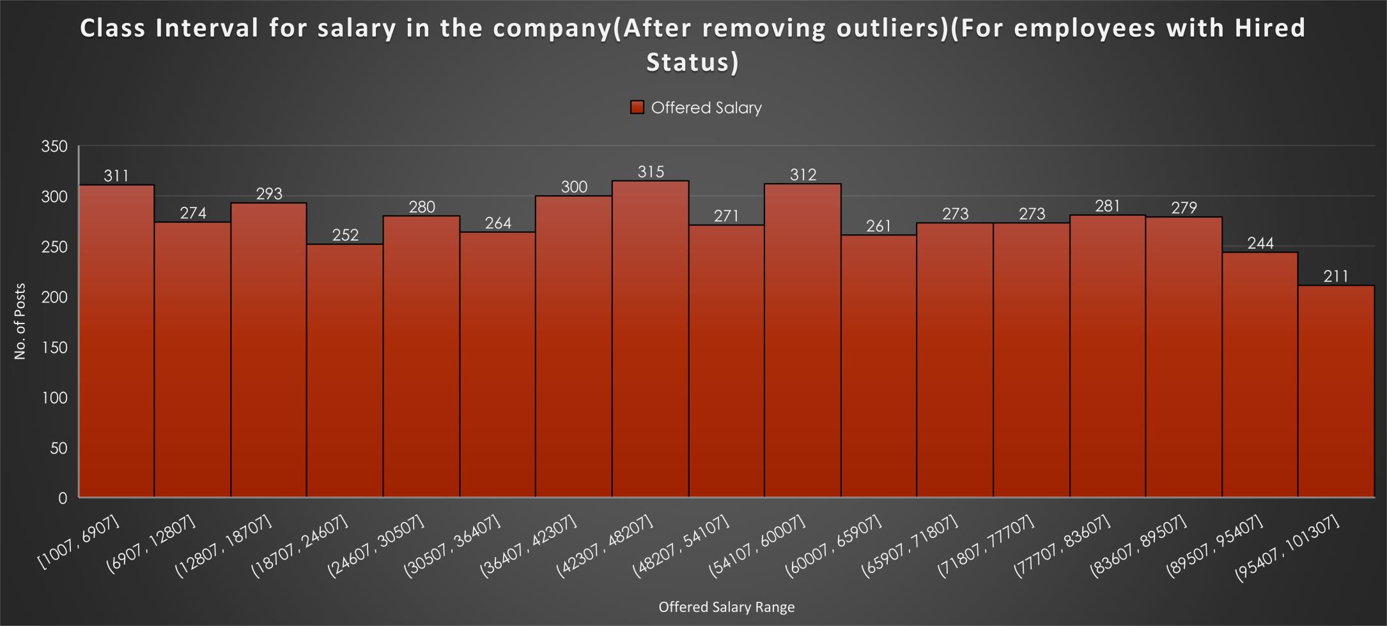
Class Intervals
CLASS INTERVALS
The class interval is the difference between the upper class limit and
the lower class limit.
Your task: Draw the class intervals for salary in the company ?

Slide 6
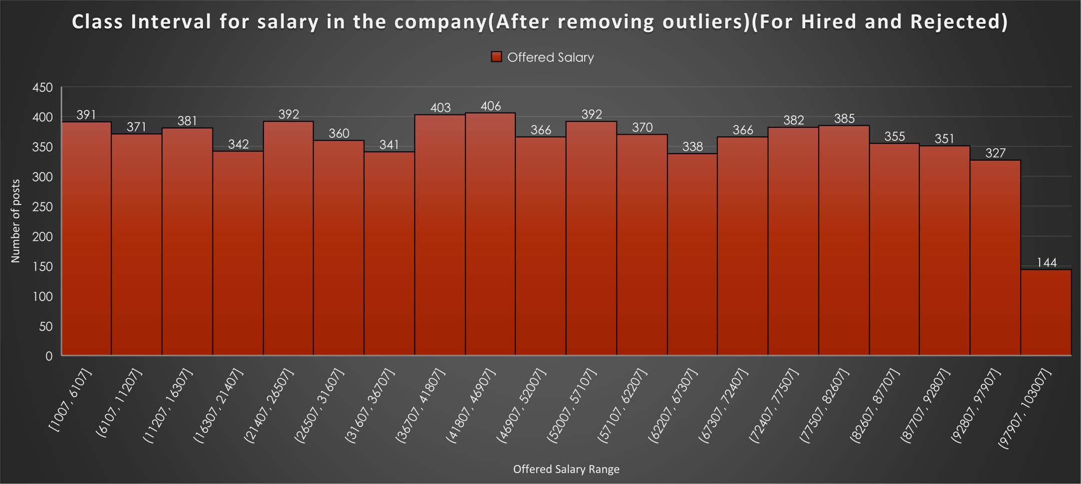
.
.
Class Intervals
Class Intervals:
The class interval is the difference between the upper class limit and
the lower class limit.
Your task: Draw the class intervals for salary in the company ?

Slide 7
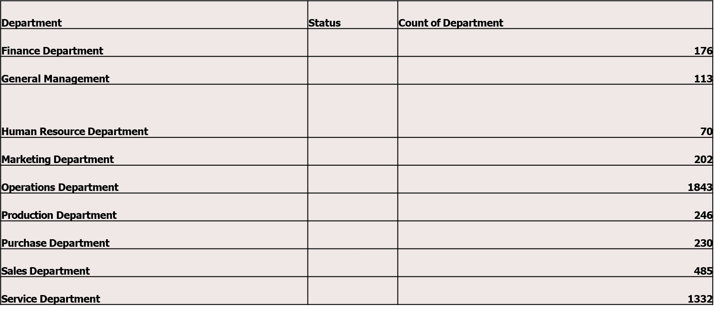
.
.
Charts and Plots
Charts and Plots:
This is one of the most important part of analysis to visualize the data.
Your task: Draw Pie Chart / Bar Graph ( or any other graph ) to show proportion of people working different department ?

Slide 8























.
Charts and Plots:
This is one of the most important part of analysis to visualize the data.
.
Your task: Draw Pie Chart / Bar Graph ( or any other graph ) to show proportion of people working different department ?
Proportion of people working in different department
General Management, 113, 3%
Human Resource Department,
70, 2%
Finance Department, 176, 4%
Marketing Department, 202, 4%
Finance Department
General Management Human Resource Department Marketing Department Operations Department Production Department Purchase Department
Sales Department Service Department
Service Department, 1332, 28%
Operations Department, 1843,
39%
Sales Department,
485, 10%
Purchase Department, 230, 5%
Production Department, 246,
5%

Slide 9















.
.
Charts and Plots
Charts and Plots:
This is one of the most important part of analysis to visualize the data.
Your task: Draw Pie Chart / Bar Graph ( or any other graph ) to show proportion of people working different department ?
.
Proportion of people working in different department
Service Department
1332
Sales Department
485
Purchase Department
230
Production Department
246
Operations Department
1843
Marketing Department
202
Human Resource Department 70
General Management
113
Finance Department
176
0
200
400
600
800
1000
1200
1400
1600
1800
2000

Slide 10
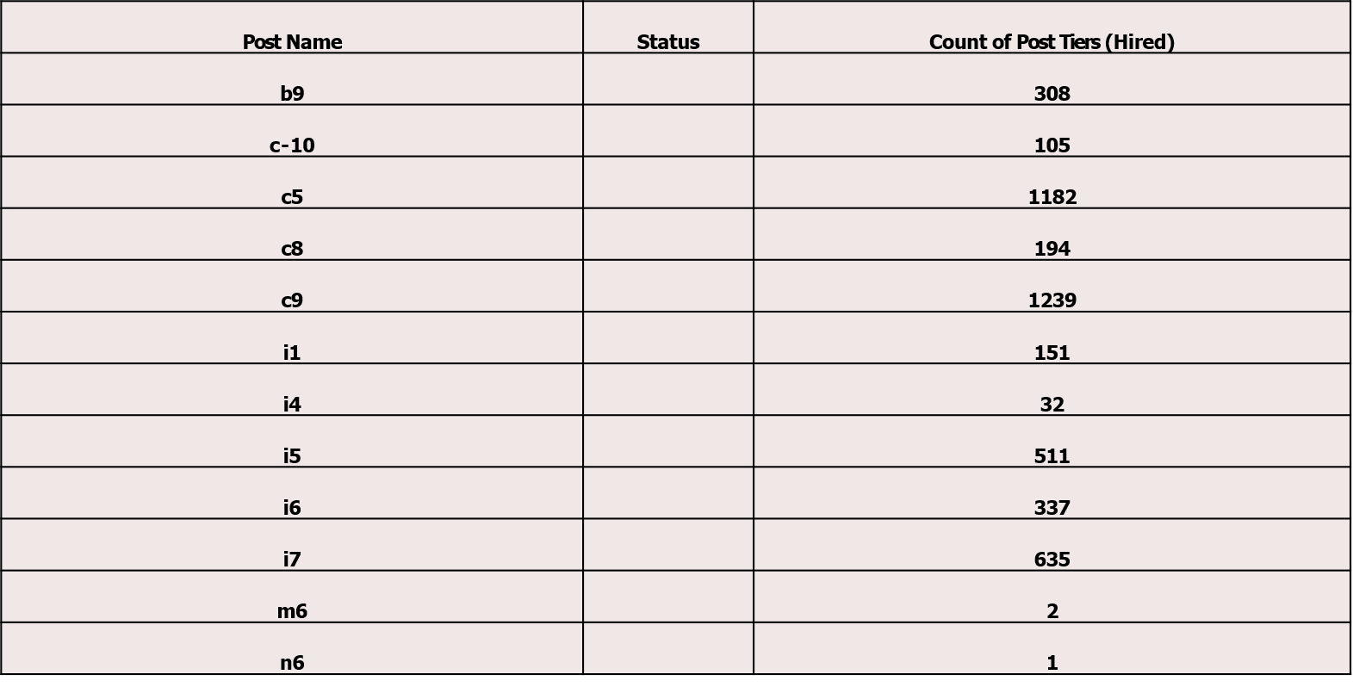
.
.
Charts(Hired)
Charts:
Use different charts and graphs to perform the task representing the data.
Your task: Represent different post tiers using chart/graph
.

Slide 11














.
Charts(Hired)
Charts:
Use different charts and graphs to perform the task representing the data.
Your task: Represent different post tiers using chart/graph
Count of Post Tiers (Hired)
.
1747
1792
982
787
527
463
321
232
222
88
3
1
1
1
1

Slide 12





































.
.
Charts(Hired)
Charts:
Use different charts and graphs to perform the task representing the data.
Your task: Represent different post tiers using chart/graph
Count of Post Tiers (Hired)
.
n10, 1, 0%
n6, 1, 0%
m7, 1, 0% n9, 1, 0%
m6, 3, 0%
c-10, 232, 3%
b9, 463,
7%
b9
c-10
c5 c8
c9 i1
i4 i5 i6
i7 m6 m7
n10 n6
n9
i7, 982, 14%
i6, 527, 7%
c5, 1747, 24%
i5, 787, 11%
i4, 88, 1%
i1, 222, 3%
c8, 321, 5%
c9, 1792, 25%

Slide 13
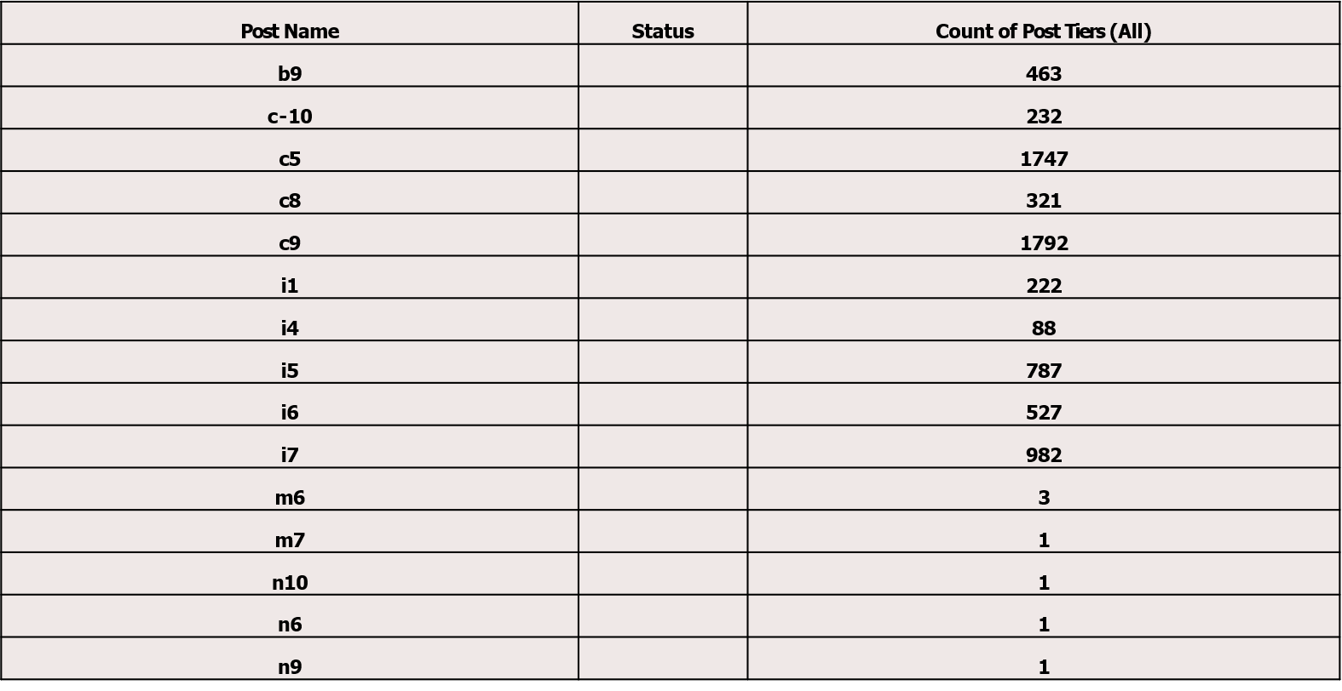
.
.
Charts(Hired+Rejected)
Charts:
Use different charts and graphs to perform the task representing the data.
Your task: Represent different post tiers using chart/graph
.

Slide 14














.
Charts(Hired+Rejected)
Charts:
Use different charts and graphs to perform the task representing the data.
Your task: Represent different post tiers using chart/graph
Count of Post Tiers (All)
1747
1792
982
787
527
463
321
232
222
88
3
1
1
1
1

Slide 15































.
Charts:
Use different charts and graphs to perform the task representing the data.
Your task: Represent different post tiers using chart/graph
Count of Post Tiers (All)
m6, 3, 0%
m7, 1, 0%
n10, 1, 0% n6, 1, 0%
n9, 1, 0%
c-10, 232, 3%
b9, 463,
7%
b9
c-10
c5 c8
c9 i1
i4 i5 i6
i7 m6 m7
n10 n6 n9
i7, 982, 14%
i6, 527, 7%
c5, 1747, 24%
i5, 787, 11%
i4, 88, 1%
i1, 222, 3%
c8, 321, 5%
c9, 1792, 25%

Slide 16
Hence, all the questions given as a part of Data Analytics Trainee
Task 4: Hiring Process Analytics have been provided with answers along with graphs
In this task all the concepts regarding to Excel and statistics have been implemented using Microsoft Excel
.
Google Drive Link for the Updated and edited Excel sheet
https://docs.google.com/spreadsheets/d/1n3QGv-IArV9zHhFXFWcJk_nBOBKYOjR3/edit?usp=sharing&ouid=101976269119944283329&rtpof=true&sd=true

